Slide 1

Programming 2nd semester

Slide 2
Course Introduction
The course Programming on the 2nd semester builds upon the 1st semester course and is closely connected to System development. The course is divided into four parts:
Databases
Data Structures
Patterns, Lambda Expressions
Parallel programming
In the following the Database part is introduced.
Notes:
SW project

Slide 3
Course Introduction
The Database Course includes 6 modules with lectures and exercises and a workshop: “Workshop Persistence”.
After this course you should be able to:
Explain the fundamental concepts of databases and give an overview of the database area.
Explain the relational database model and design relational databases.
Program databases in SQL.
Access and manipulate relational databases from Java applications.
Notes:
SW project

Slide 4
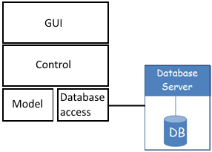
Layered architecture
Layers
Notes:
SW project

Slide 5
Canvas
Syllabus
Etc.
Notes:
SW project

Slide 6

Introduction to databases
Databases are very important parts of most software systems, so a comprehensive knowledge is required for all software developers.

Slide 7
Intended Learning Outcomes (ILOs) Session 01
Can explain the basic concepts of databases and the relational model
Can navigate in an relational database
Can create a database in MS SQL Server using scripts (i.e. “The Company Database”)
Can do simple SQL queries on a database in MS SQL Server.

Slide 8
Session 01
Readings:
Elmasri: chap. 1, 2 and 5
Task
Get MS SQL Server and the Management Studio installed and working.

Slide 9
Install a database!
Microsoft SQL Server EXPRESS 2017
https://www.microsoft.com/da-dk/sql-server/sql-server-editions-express
Click “Install SSMS” when the installer has completed
Microsoft SQL Server Management Studio
https://docs.microsoft.com/en-us/sql/ssms/download-sql-server-management-studio-ssms
BIG & slow downloads
Requires at least Windows 8
If no windows8+
VirtualBox
Extensions (when VirtualBox is installed)
Windows 10 from Dreamspark (45 G HDD seems enough, 2-4 G memory, 2 cores)
Remember to take a screenshot of the activation code on Dreamspark

Slide 10
While we wait
Some theory about databases

Slide 11

Database System Concepts and Architecture

Slide 12


(SQL) Databases in Practice
Websites
Desktop applications
Mobile development
Computer
Mobile phone
Your app
Your application
Internet
Android, iOS
Web server
Java EE, .Net, PHP, …
Embedded DB
Internet / LAN
LAN
SQLite
SQL DB
SQL DB

Slide 13
End users
External view
External view
.......
Conceptual Schema
Internal Schema
Stored database

Slide 14
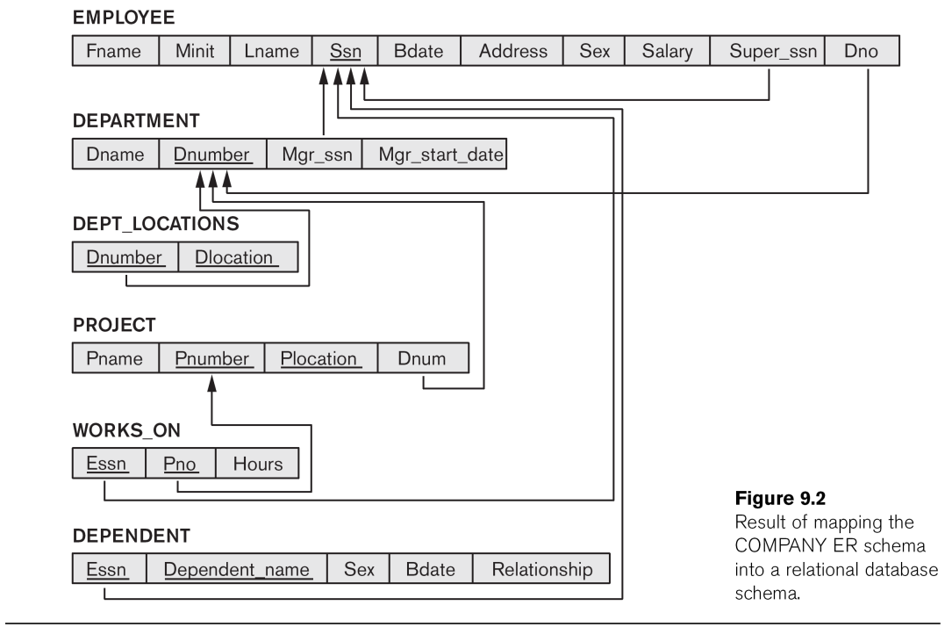
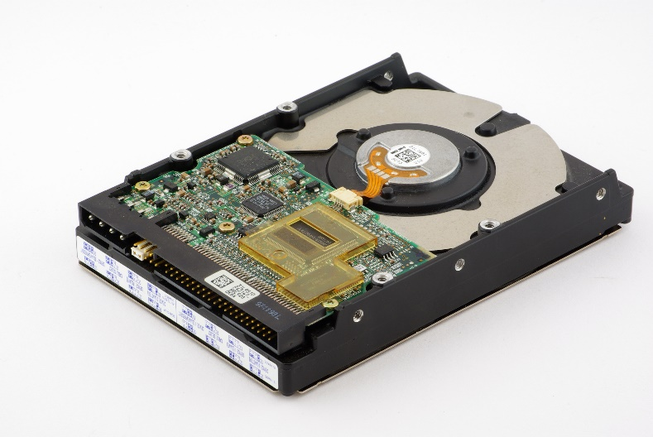
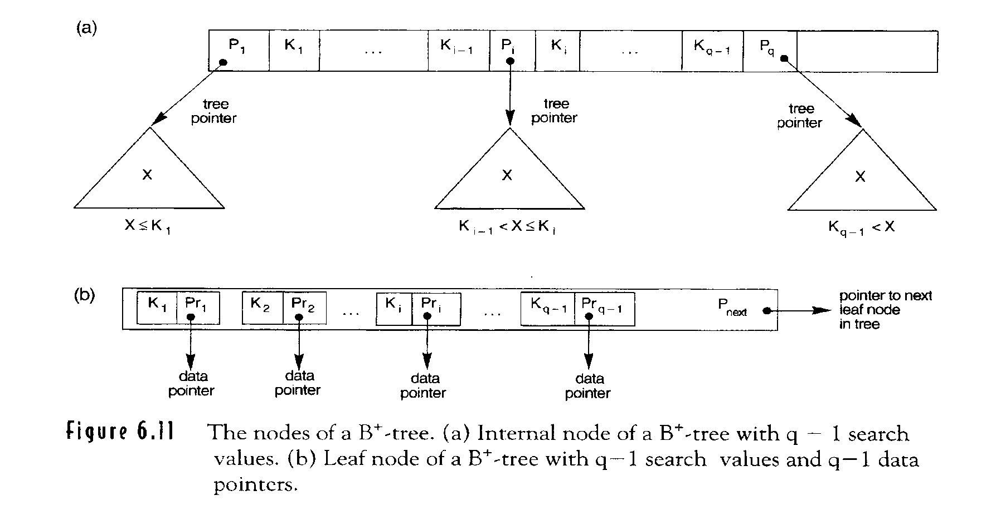
End users
External view
External view
.......
Conceptual Schema
Internal Schema
Stored database

Slide 15
End users
External view
External view
.......
Data independence
Conceptual Schema
Internal Schema
Stored database

Slide 16
Three-Schema Architecture
Defines DBMS schemas at three levels:
External schemas at the external level to describe the various user views. Usually uses the same data model as the conceptual level.
Conceptual schema at the conceptual level to describe the structure and constraints for the whole database for a community of users. Uses a conceptual or an implementation data model.
Internal schema at the internal level to describe physical storage structures and access paths. Typically uses a physical data model.

Slide 17
Database schema
Database Schema: The description of a database. Includes descriptions of the database structure and the constraints that should hold on the database. Schema Diagram: A diagrammatic display of (some aspects of) a database schema.

Slide 18
Database Schema
Schema Diagram: A diagrammatic display of (some aspects of) a database schema.

Slide 19
Database instance / state
Database Instance: The actual data stored in a database at a particular moment in time. Also called database state (or occurrence).

Slide 20
Database Schema vs. Database State
Database State: Refers to the content of a database at a moment in time.
Valid State: A state that satisfies the structure and constraints of the database.
Distinction
The database state changes every time the database is updated.
The database schema changes very infrequently.

Slide 21
DBMS Languages
SQL includes e.g.:
DDL
DML

Slide 22
DBMS Languages
Data Definition Language (DDL): Used by the DBA and database designers to specify the conceptual schema of a database. Create tables etc.

Slide 23
DBMS Languages
Data Manipulation Language (DML): Used to specify database retrievals and updates.
DML commands can be embedded in a general-purpose programming language (host language), such as Java or C#.
Alternatively, stand-alone DML commands can be applied directly (query language). SQL Server 2014 Management Studio

Slide 24
DBMS Languages
High Level or Non-procedural Languages: e.g., SQL, are set-oriented and specify what data to retrieve and not how to retrieve them. Also called declarative languages.
Low Level or Procedural Languages: record-at-a-time; they specify how to retrieve data and include constructs such as looping. Example: “Stored procedures”
SQL: Structured Query Language [ess-kyu-ell]

Slide 25


Trivia – SQL or “sequel”
Since the language was originally named SEQUEL, many people continued to pronounce the name that way after it was shortened to SQL. Both pronunciations are widely used and recognized. As to which is more “official”, I guess the authority would be the ISO Standard, which is spelled (and presumably pronounced) S-Q-L.
Thanks for your interest, Don Chamberlin
http://patorjk.com/blog/2012/01/26/pronouncing-sql-s-q-l-or-sequel/
The guy who developed SQL
Hello, I am a Mac and I am a PC
https://www.youtube.com/watch?v=0eEG5LVXdKo

Slide 26
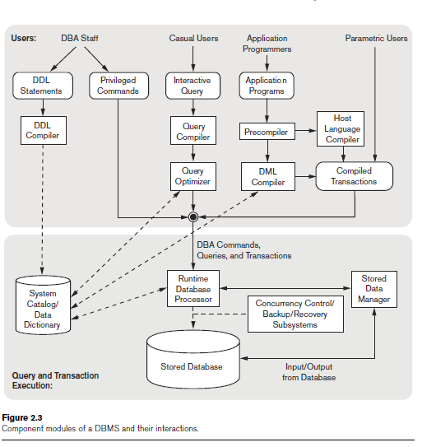
DBMS Components & Function

Slide 27
Database System Utilities
To perform certain functions such as:
Loading data stored in files into a database. Includes data conversion tools.
Backing up the database periodically on tape.
Reorganizing database file structures.
Report generation utilities.
Performance monitoring utilities.
Other functions, such as sorting, user monitoring, data compression, etc.

